Slide 1
Verilog HDL -Introduction
VLSI Group –DAIICT
Kishore, Aditya & Harsha
Ref: Verilog – HDL by samir palnitkar 2nd Edition

Slide 2
Module- Basic building block
A module can be an element or collection of low level design blocks

Slide 3
Levels of Abstraction-1
Switch Level: Module implemented with switches and interconnects. Lowest level of Abstraction
Gate Level: Module implemented in terms of logic gates like (and ,or) and interconnection between gates

Slide 4
Levels of Abstraction-2
Dataflow Level: Module designed by specifying dataflow. The designer is aware of how data flows between hardware registers and how the data is processed in the design
Behavioral Level :Module can be implemented in terms of the desired design algorithm without concern for the hardware implementation details. Very similar to C programming

Slide 5
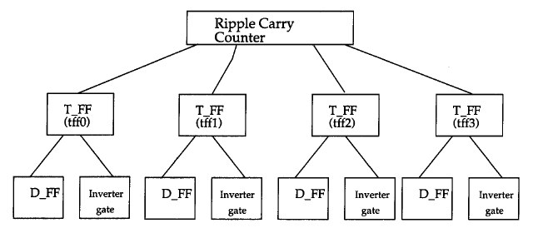
Hierrarchy

Slide 6
Basic Concepts
Number is specified as
<size>'<baseformat><number>

Slide 7
Contd.

Slide 8
Nets
Nets represent connections between hardware elements. Just as in real circuits, nets have values continuously driven on them by the outputs of devices that they are connected to.

Slide 9
Registers
Registers represent data storage elements. Registers retain value until another value is placed onto them.
In Verilog, the term register merely means a variable that can hold a value.
Unlike a net, a register does not need a driver.

Slide 10
Vectors
Arrays of Regs and Nets

Slide 11

Integers and Parameters

Slide 12
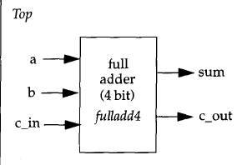
Ports
Ports provide interface for by which a module can communicate with its environment

Slide 13
Module

Slide 14
Port connection rules

Slide 15
Example

Slide 16
Connecting Ports
Suppose we have a module

Slide 18
Gate Level Modeling
A logic circuit can be designed by use of logic gates.
Verilog supports basic logic gates as predefined primitives. These primitives are instantiated like modules except that they are predefined in Verilog and do not need a module definition.

Slide 19
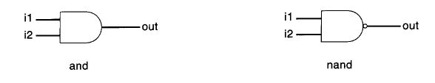
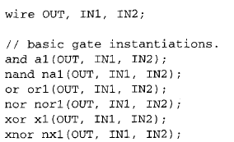
Gate gate_name(out,in1,in2…)

Slide 20
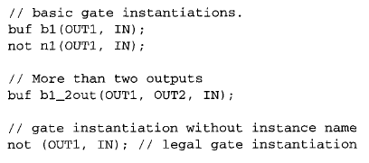
Buf/not gates
Buflnot gates have one scalar input and one or more scalar outputs.

Slide 21
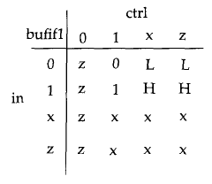
Bufif/notif

Slide 22
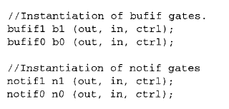
Instantiation of bufif gates

Slide 23
Design of 4:1 Multiplexer

Slide 24
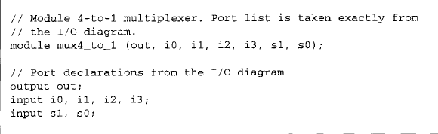
Contd..

Slide 26
Stimulus

Slide 28
4 bit full adder

Slide 29
Declaration:

Slide 30
Code contd..

Slide 31
4 bit adder using 1 bit adder

Slide 32
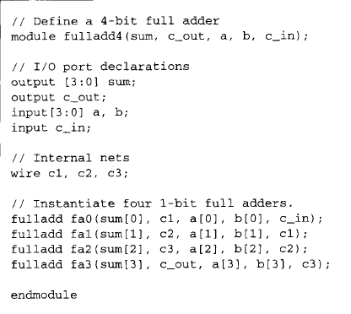

Slide 33
Stimulus

Slide 34


Gate Delays:
Rise Delay: Delay associated with a o/p transition to 1 from any value.
Fall Delay: Delay associated with o/p transition to 0 from any value.
Turn off Delay: Delay associate with o/p transition to Z from another value.

Slide 35
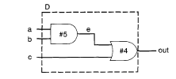

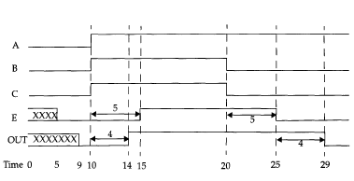

Slide 36
Dataflow Modeling
In complex designs the number of gates is very large
Currently, automated tools are used to create a gate-level circuit from a dataflow design description. This process is called logic synthesis

Slide 37
Continuous Assignment

Slide 38
Rules:
The left hand side of an assignment must always be a scalar or vector net
It cannot be a scalar or vector register.
Continuous assignments are always active.
The assignment expression is evaluated as soon as one of the right-hand-side operands changes and the value is assigned to the left-hand-side net.

Slide 39
The operands on the right-hand side can be registers or nets.
Delay values can be specified for assignments in terms of time units. Delay values are used to control the time when a net is assigned the evaluated value

Slide 41
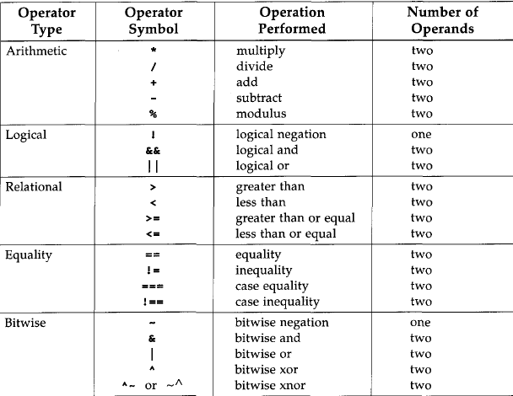
Operator Types

Slide 43
Conditional Operator

Slide 44
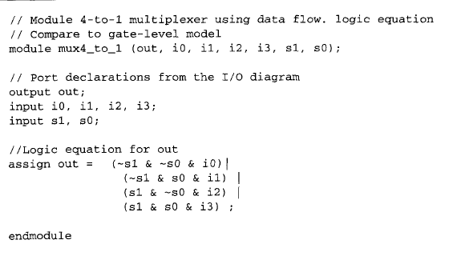
4:1 Multiplexer Example

