Slide 1
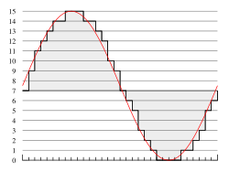
ECE 242
Data Structures
Lecture 30
Data Compression
Notes:
Give qualifications of instructors:
DAP
teaching computer architecture at Berkeley since 1977
Co-athor of textbook used in class
Best known for being one of pioneers of RISC
currently author of article on future of microprocessors in SciAm Sept 1995
RY
took 152 as student, TAed 152,instructor in 152
undergrad and grad work at Berkeley
joined NextGen to design fact 80x86 microprocessors
one of architects of UltraSPARC fastest SPARC mper shipping this Fall

Slide 2
Motivation for Data Compression
Big data
  Google and Yahoo processes 10s of Petabyte data per day
Text files and images
  Everywhere
Audios and videos
  Each sample is a sound or an image
  Many samples per second

Slide 3
Digital Audio
Sampling the analog signal
  Sample at some fixed rate
  Each sample is an arbitrary real number
Quantizing each sample
  Round each sample to one of a finite number of values
  Represent each sample in a fixed number of bits
4 bit representation
(values 0-15)

Slide 4

Audio Examples
Speech
  Sampling rate: 8000 samples/second
  Sample size: 8 bits per sample
  Rate: 64 kbps
Compact Disc (CD)
  Sampling rate: 44,100 samples/second
  Sample size: 16 bits per sample
  Rate: 705.6 kbps for mono,
  1.411 Mbps for stereo

Slide 5
Audio Compression
Audio data requires too much bandwidth
  Speech: 64 kbps is too high for a dial-up modem user
  Stereo music: 1.411 Mbps exceeds most access rates
Compression to reduce the size
  Remove redundancy
  Remove details that human tend not to perceive
Example audio formats
  Speech: GSM (13 kbps), G.729 (8 kbps), and G.723.3 (6.4 and 5.3 kbps)
  Stereo music: MPEG 1 layer 3 (MP3) at 96 kbps, 128 kbps, and 160 kbps

Slide 6

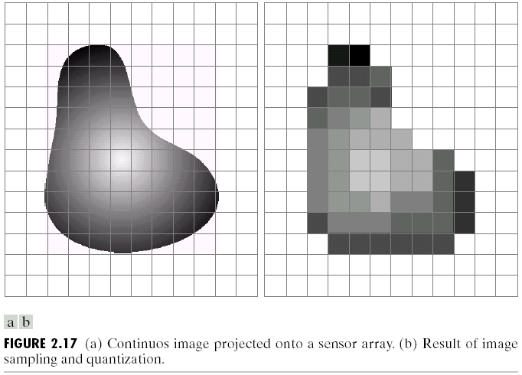
Digital Video
Sampling the analog signal
  Sample at some fixed rate (e.g., 24 or 30 times per sec)
  Each sample is an image
Quantizing each sample
  Representing an image as an array of picture elements
  Each pixel is a mixture of colors (red, green, and blue)
  E.g., 24 bits, with 8 bits per color

Slide 7
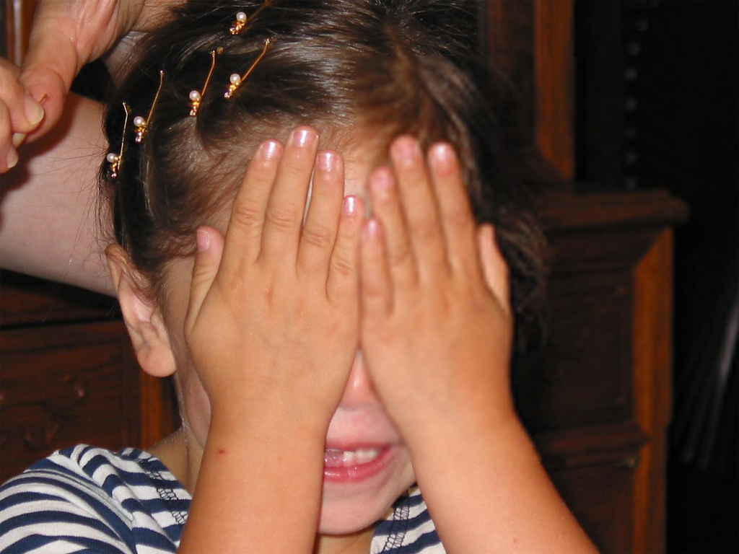
The
2272 x 1704
hand
The
320 x 240
hand

Slide 8



Video Compression: Within an Image
Image compression
  Exploit spatial redundancy (e.g., regions of same color)
  Exploit aspects humans tend not to notice
Common image compression formats
  Joint Pictures Expert Group (JPEG)
  Graphical Interchange Format (GIF)
Uncompressed: 167 KB
Good quality: 46 KB
Poor quality: 9 KB

Slide 9
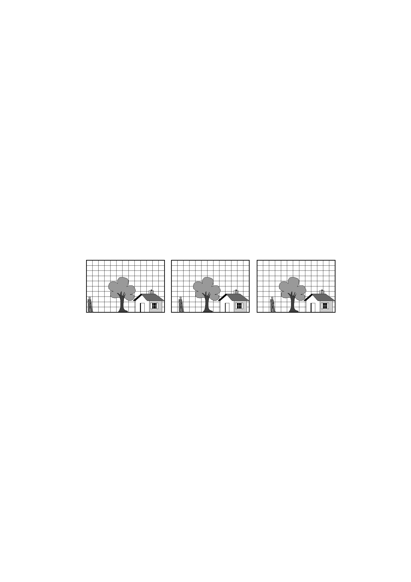
Video Compression: Across Images
Compression across images
  Exploit temporal redundancy across images
Common video compression formats (~26:1)
  MPEG 1: CD-ROM quality video (1.5 Mbps)
  MPEG 2: high-quality DVD video (3-6 Mbps)
  Proprietary protocols like QuickTime

Slide 10
Compression is necessary for storage and transmission
Data Storage
  Hard disk access rate: 115MB/s
  Access 1 Terabyte of data from hard disk needs 2.3 hours
Data Delivery over Network
  Local Area:
    Gigabit Ethernet bandwidth: 125 MB/s
  Wide Area
    ADSL or Cable Modem: 1.5 Mb/s

Slide 11
Text Compression
Files can often be compressed.
  Represented using fewer bytes than the standard representation.
Fixed-length encoding
  Somewhat wasteful, because some characters are more common than others.
  If a character appears frequently, it should have a shorter representation.

Slide 12
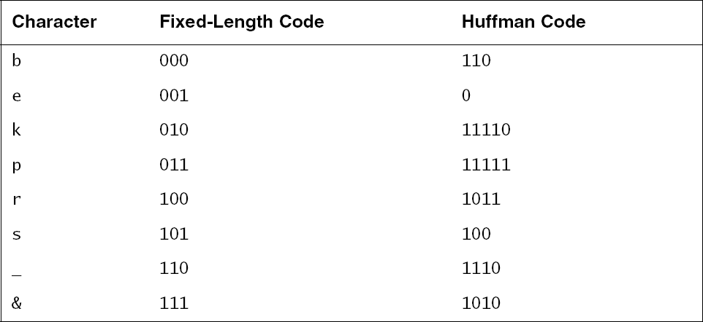
Compression
“beekeepers & bees”
000 001 001 010 001 001 011 001 100 101 110 111 110 000 001 001 101
110 0 0 11110 0 0 11111 0 1011 100 1110 1010 1110 110 0 0 100

Slide 13
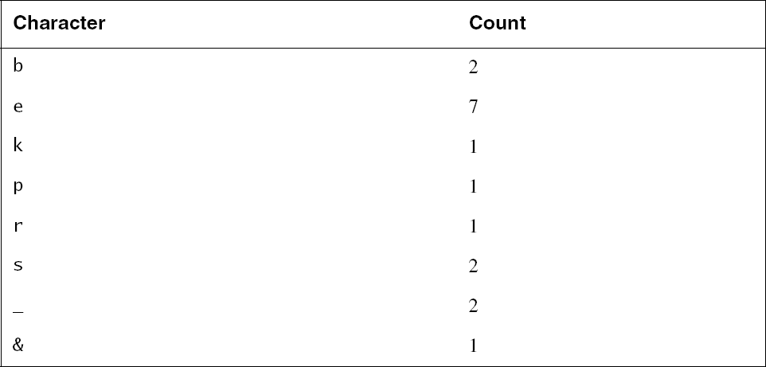
Compression
Huffman encodings are designed so that no code is a prefix of another code.

Slide 14
Compression
First construct a binary tree.
  On each pass through the main loop, we choose the two lowest-count roots and merge them.
  Ties don't matter.
  Count for the new parent is the sum of its children's counts.

Slide 15
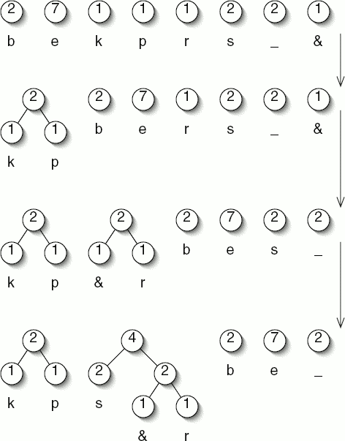
Compression

Slide 16
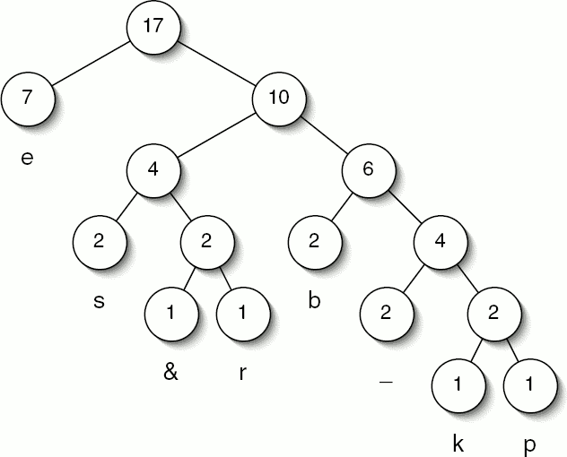
Compression

Slide 17
Compression
The code for each character is determined by the path from the root to the corresponding leaf.
  Right is 1
  Left is 0
  'b' is right-right-left and its code is 110

