Slide 1
Data structures & algorithms in Java
ECE242 – Exam Review
By Daniel Gomez-Prado
Sept 2012

Slide 2
Outline
Analysis of complexity
  Q1 Fall 2011 problems
Classes, objects and containers
Array
Stack
Queue
(Single) Linked and Double Linked List
Iterators
Linear and Binary search
Merge sort
Quick sort
Q2 – Q6, Fall 2011 problems

Slide 3
Analysis big-Oh
Random access memory
Assumptions:
  Unlimited memory
  All memory accesses takes 1 unit time
Your program
Memory
Import java.util.*
class review {
Static public main() {
// this is a review
// for ECE242 exam
}
}
We have what we need: 1 Gb or 1,000 Tb
No hierarchical memory,
Cache, L1, L2, hard drive

Slide 4
Analysis big-Oh
Running time
PROGRAM OPERATIONS STEPS
int sum = 0; 1 assignment 1
for (i=0;i<128;i=++) i =1, 2, 3, 4 … 128 128
for (j = 128; j>0; j=j/2) j = 128,64,32,16,8,4,2,1 log₂128+1
sum = sum + a[i][j]; 1 addition, 1 assignment 2
1+128*(log₂128+1)*2
n could be the size of the stack, queue, list or the dimension of a matrix, etc.
In general we have an arbitrary number “n” instead of 128, in that case:
1+n*(log₂n+1)*2
1+2n+2n*log₂n
can we simplify the expression?
YES!, By using big-Oh notation
we can specify the asymptotic
complexity of the algorithm
Notes:
A 4 line segment of code, and what is its number of steps? 1+2n+2n*log2(n). Now repeat it after me “1+2n+2n*log2(n)”,
Can you imagine writing a 5000 line code segment and doing this level of detailed analysis and then reporting the number
of steps?

Slide 5
Analysis big-Oh
Definition
Given functions f(n) and g(n):
  f(n) is said to be O(g(n))
  if and only if
    there are (exist) 2 positive constants, C>0 and N>0
  such that
    f(n) ≤ Cg(n) for every n>N

Slide 6
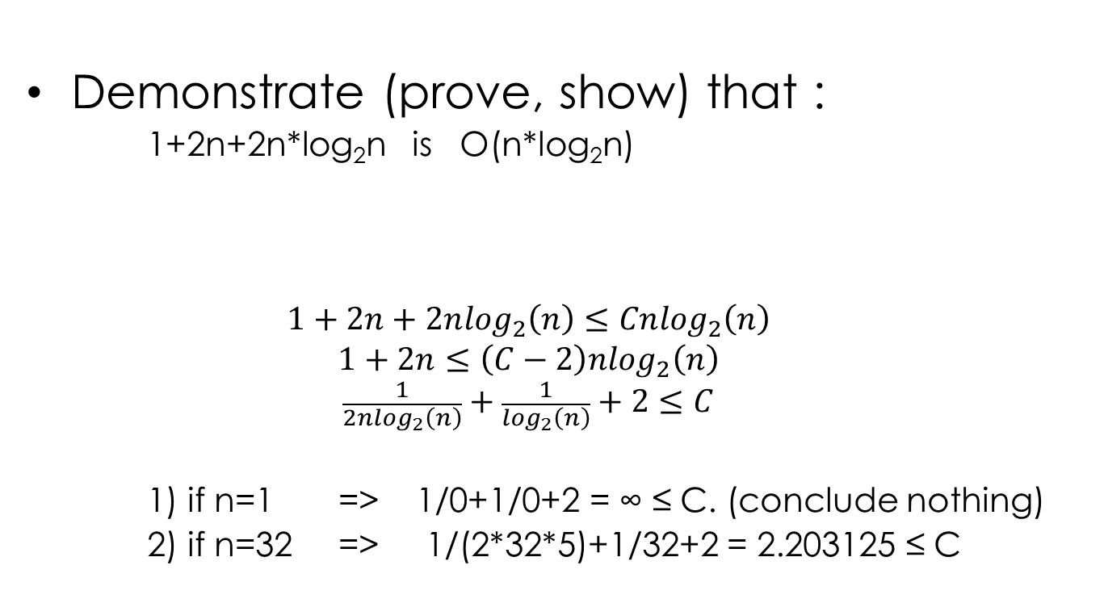
Analysis big-Oh
Example of definition usage
keywords
Demonstrate (prove, show) that :
  1+2n+2n*log₂n is O(n*log₂n)
  $$1+2n+2n\log_{2}\left(n\right)≤Cn\log_{2}\left(n\right) \\ 1+2n≤\left(C−2\right)n\log_{2}\left(n\right)$$
  $$\frac{1}{2n\log_{2}\left(n\right)}+\frac{1}{\log_{2}\left(n\right)}+2≤C$$
  1) if n=1 => 1/0+1/0+2 = ∞ ≤ C. (conclude nothing)
  2) if n=32 => 1/(2*32*5)+1/32+2 = 2.203125 ≤ C
f(n) is given g(n) is given
Relationship between C & n
O(n*log₂n) is true
for C=3 and n≥32

Slide 7
Analysis big-Oh
Q1 exam1 Fall 2011
State the asymptotic complexity of:
Print out middle element of an array of size n
big-Oh
arrays allow access to
any position randomly
recall
Your program
Memory
Solution is:
O(1)
  All memory accesses takes 1 unit time

Slide 8
Analysis big-Oh
Q1 exam1 Fall 2011
Print out the middle element of a linked list of size n
recall a linked list
head
tail
next
next
next
next
n/2
memory
locations
object
object
object
object
f(n) = n/2
Solution is: the asymptotic complexity is O(n)
Notes:
Many of you will be tempted to provide n/2 as answer, guess what is going to be the grade for those who fall into temptation?

Slide 9
Analysis big-Oh
Q1 exam1 Fall 2011
Print out the odd elements of an array of size n
Pop 10 elements from a stack that is implemented with an array. Assume that the stacks contains n elements and n > 10.
f(n) = n/2
Solution: the asymptotic complexity is O(n)
When in doubt, ASK! is n = 11 or is n > 1000 ?
f(n) = 10
Solution: the asymptotic complexity is O(1)
Notes:
Many of you will be tempted to provide n/2 as answer, guess what is going to be the grade for those who fall into temptation?

Slide 10
Classes and objects
The goal of a “class” (in object-oriented language)
  Encapsulate state and behavior
A class is a blueprint that has
  a constructor to initialize its data members
  a destructor to tear down the object
  A coherent interface to interact with the object (public methods)
  Private methods unreachable from the outside
  The possibility to extend and inherit members from other classes
An object is an instant of a class
What are the benefits:
  Through inheritance, extensions, packages allows to structure a program
  Exposes behavior that could be reused
  Alleviates the problem of understanding somebody else code

Slide 11
ADT
(Abstract Data Type)
ADTs are containers
ADTs are primarily concern in:
  Aggregation of data
  Access of data
  Efficiency of memory is used
  Efficiency of the container access

Slide 12
Arrays
Contiguous blocks of memory of a data type
  Any position can be randomly access
Example
  Int[] integer_array = new int[1024];
  ObjectY[] object_y_array = new ObjectY[512];
int size
0
1023
Java takes care of the
memory management
for you.
1,934,218
ObjectX
ObjectY size
0
ObjectZ
0
511
…
…
512 ObjectsY
fixed boundary

Slide 13
Stacks
Enforce a LIFO behavior (last in, first out)
  It is based on an array
  It overrides the random access of an array by a LIFO access
behavior
isEmpty
true
isEmpty
false
isEmpty
false
peek
push
pop
1023
0
1023
1023
0
0
pop
status
peek
index
push
push

Slide 14
Stacks
0
…
Enforce a LIFO behavior (last in, first out)
  It is based on an array
  It overrides the random access of an array by a LIFO access
ObjectZ
Recall what a class encapsulates
Status &
Behavior
isEmpty
false
pop
1023
0
Does it mean we are always safe
index = -1,
  stack is empty, good
  index = 1024,
    refuse to push objects
  overflow, runtime exception
-1
1024
peek
index

Slide 15
Queues
Enforce a FIFO behavior (first in, first out)
  It is based on an array
  It overrides the random access of an array by a FIFO access
isEmpty
true
isEmpty
false
isEmpty
false
status
peek
enqueue
peek
index1
1023
0
1023
1023
0
0
index2
dequeue
enqueue
enqueue
dequeue

Slide 16
Queues
Enforce a FIFO behavior (first in, first out)
  It is based on an array
  It overrides the random access of an array by a FIFO access
Recall what a class encapsulates
Status &
Behavior
isEmpty
false
status
peek
index1
Does it mean we are always safe
index1 = index2,
  stack is empty, good
  index1 or index2 = 1024,
    rewind to 0
      test condition
      Increment using mod 1024
  What if index2 > index1
1023
0
>
index2
dequeue
dequeue

Slide 17
Queues
Enforce a FIFO behavior (first in, first out)
  It is based on an array
  It overrides the random access of an array by a FIFO access
status
>
status
index2
>
peek
index1
0
1023
1023
0
index2
peek
index1
dequeue
dequeue

Slide 18
Is everything an Array? can we use something else?
Recall an array
  Contiguous memory
  Fixed bound size
  Random access
Let’s use another construct
  Non contiguous memory
  Unlimited size
  Sequential access only
beginning
end
ObjectX
0
ObjectY
N-1
0
ObjectZ
…
…
fixed boundary
How do we know in this container?
the beginning, the end
which element is next
ObjectX
ObjectY
ObjectZ
…
…
head
next
edges
prev
next
next
Node
head
object
object

Slide 19
Linked List
Use the prior construct (node and edge)
head
next
next
next
next
…
object
object
object
push
next
pop
peek
object

Slide 20
Double linked List
Use the prior construct (node and edge)
head
prev
next
prev
next
prev
next
…
prev
next
object
object
object

Slide 21
Quick Questions
Can we do:
a linked list or double linked list from an array
  Yes
a queue with nodes and edges
  Why not.
a stack with nodes and edges
  Sure

Slide 22
Iterators encapsulate container traversals
we have two implementations of a stack
peek push pop
pop
prev
next
0
1023
prev
next
1
2
3
4
head
peek
index
prev
next
prev
4
next
prev
3
next
push
prev
2
next
prev
1
next
Notes:
Recall what a class encapsulates ?

Slide 23
Iterators encapsulate container traversals
we have two implementations of a stack
Traverse container
according to container rules
behavior
state
update next
update prev
prev
next
1023
head
0
increment by 1
decrement by 1
1
2
3
4
5
prev
next
prev
5
next
peek
index
prev
4
next
prev
3
next
push
prev
2
next
prev
1
next
Notes:
Recall what a class encapsulates ?

Slide 24
Searching
Linear vs Binary
If you make no assumptions
  iterate (traverse) all elements to find an existing element
  iterate (traverse) all elements to realize you don’t have an element
If you assume the container is already order (according to certain rule)
  Iterate back/forth skipping some elements to speed up the process
Looking for u
worst case all elements
are visited. O(n)
a
x
z
b
n
m
l
j
i
b
c
u
worst case there are log(n)+1
element visited. O(log(n))
a
b
b
c
i
j
l
n
m
u
x
z
Looking for u

Slide 25
So binary search is faster but the assumption is…
The container is already order, so
  how do we sort a container
  how do insert elements in a sorted container
  How do we remove elements in a sorted container
What is more expensive (big-Oh)
  A linear search
  Order a container and then a binary search
  Maintain a container sorted and then a binary search

Slide 26
Sorting a container
Merge sort
Use the divide and conquer approach
  Divide the problem into 2 subsets (unless you have a base case)
  Recursively solve each subset
  Conquer: Solve the sub-problem and merge them into a solution
85 24 63 45 19 37 91 56
DIVIDE
Wait, what?
24 45 63 85
19 37 91 56
85 24 63 45
CONQUER
RECUR
24 85
85 24
63 45
45 63
take the min
24 85
85
85
24 45
24
45 63
45 63
63

Slide 27
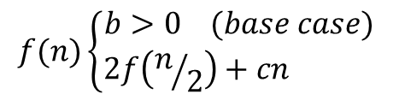
Sorting a container
Merge sort
What is the complexity of merge sort
  Divide the problem into 2 subsets (2 times half the problem)
  Recursively solve each subset (keep subdividing the problem)
  Conquer: Solve the sub-problem and merge (the merge running time)
f(n)
85 24 63 45 19 37 91 56
2f(n/2)
85 24 63 45
19 37 91 56
4f(n/4)
85 24
63 45
$$f(n)\left\{\begin{matrix}b>0 (base case) \\ 2f\left(n/2\right)+cn \end{matrix}\right.$$
log2(n)
24 85
x elements
O(x+y)
24 45
45 63
y elements

Slide 28
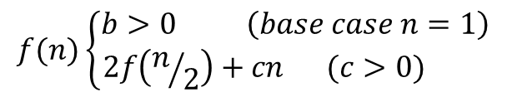

Sorting a container
Merge sort
What is the complexity of merge sort
  Divide the problem into 2 subsets (2 times half the problem)
  Recursively solve each subset (keep subdividing the problem)
  Conquer: Solve the sub-problem and merge (the merge running time)
$f\left(n\right)=2f\left(n/2\right)+cn$
$f\left(n\right)=2[2f\left(n/{2^{2}}\right)+cn]+cn$
$f\left(n\right)=2[2[2f\left(n/{2^{3}}\right)+cn/{2^{2}}]+cn/2]+cn$
$f\left(n\right)=2^{3}f\left(n/{2^{3}}\right)+3cn$
$f\left(n\right)=2^{i}f\left(n/{2^{i}}\right)+icn$ where i is the number of subsets created
$i=\log_{2}\left(n\right)$
$f\left(n\right)=nf\left(n/n\right)+\log_{2}\left(n\right)cn$
$f\left(n\right)=nf\left(1\right)+{cnlog}_{2}\left(n\right)$
$f\left(n\right)=nb+{cnlog}_{2}\left(n\right)$
$$f(n)\left\{\begin{matrix}b>0 \left(base case n=1\right) \\ 2f\left(n/2\right)+cn (c>0) \end{matrix}\right.$$
O(nlogn)

Slide 29
Sorting a container
Merge sort
Drawback of merge sort algorithm
  The merge is not in place
The merge could be modified to be in place, but the overhead will slow down the running time.
take the min
Additional memory
85
24 45
63

Slide 30
Sorting a container
Quick sort
Use the divide and conquer approach
  Divide the problem into 3 subsets (unless you have a base case)
    A (random) pivot x
    A subset with numbers lower than x
    A subset with numbers greater than x
  Recursively solve each subset
  Conquer: Solve the sub-problem and merge them into a solution
85 24 63 19 37 91 56 45
24 37 19
85 63 91 56
24 37
In place sorting,
it does not require additional memory

Slide 31
Sorting a container
Quick sort
Complexity
  Quick sort (with random pivot) is O(nlogn)
Drawback
  No replicated element allowed in the container
  * The pivot is randomly chosen,
  * if an element occurs twice, in different divisions
  * then the merging mechanism won’t work

Slide 32
Arrays
Q2 exam1 Fall 2011
Accept 2 integer Arrays: A and B. And find the number of common elements in both assuming no duplicates in each array.
Brute force
O(nm)
Merge-sort modified
A, n elements
B, m elements
C, n+m elements
Instead of merging compare and increment count when equal
O( (n+m)log(n+m) )

Slide 33
Stacks and Queues
Q3 exam1 Fall 2011
Write a reverseQueue method using only stacks and queues
in
in
out
in
O(n)
a
b
c
d
e
f
g
a
h
b
c
d
e
f
g
h
h
g
f
e
d
c
b
a
out
out
Queue
FIFO
Stack
LIFO
Queue
FIFO

Slide 34
Stacks and Queues
Q3 exam1 Fall 2011
Write a method cutQueue that adds an element to the head of the queue using only stacks and queues
N
O(n)
in
in
out
in
out
in
a
b
c
d
e
f
g
h
N
a
b
c
d
h
g
f
e
d
c
b
a
N
e
f
g
h
N
a
b
c
d
e
f
g
h
out
out
Queue
FIFO
Stack
LIFO
Stack
LIFO
Queue
FIFO

Slide 35
List
Q5 exam1 Fall 2011
Write a method isSortedAsc to check if a single linked list is sorted in non-decreasing order
head
next
next
next
…
next
while ( node.next ) {
if (node.next.key < node.key)
return false;
node = node.next;
}
return true;

Slide 36
List
Q5 exam1 Fall 2011
Write a method putInPlace to insert preserving the non-decreasing order of the single linked list
head
next
next
next
…
next
if (!isSortedAsc())
return false;
while ( node.next ) {
if ( !(new_key > node.next.key) ) {
SNode new_node = new SNode(new_key,node.next);
node.next = new_node;
return true;
}
node = node.next;
}
SNode new_node = new SNode(new_key,NIL);
node.next = new_node;

Slide 37
List
Q6 exam1 Fall 2011
Write a method compress to remove duplicated elements in the single linked list
head
next
next
next
…
next
while ( node.next ) {
if ( node.key == node.next.key) ) {
node.next = node.next.next;
} else {
node = node.next;
}
}

