Slide 1
Map Examples

Slide 2
Examples
Example 1 – Hello, MapView (in slides)
Example 2 – GeoCoder (in slides)
Example 3 – Overlays (in slides)
Example 4 – MyLocation (in slides)
Example 5 - Obtain Location from GPS (in slides)

Slide 3
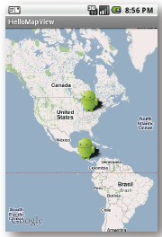
Example 1 – Hello, MapView
Create a simple Activity that can view and navigate a map.

Slide 4
Example 1– Hello, MapView
Start a new project/Activity called HelloMapView.
Because we're using the Google Maps library, which is not a part of the standard Android library, we need to declare it in the Android Manifest.
Open the AndroidManifest.xml file and add the following as a child of the <application> element:
<uses-library android:name="com.google.android.maps" />
We also need access to the internet in order to retrieve the Google Maps tiles, so the application must request the INTERNET permissions.
In the manifest file, add the following as a child of the <manifest> element:
<uses-permission android:name="android.permission.INTERNET" />

Slide 5
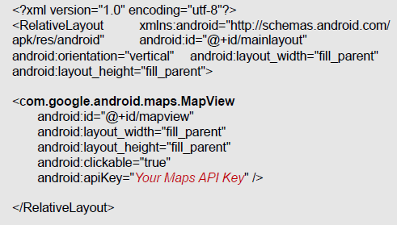
Example 1 – Hello, MapView
Now open the main layout file for your project. Define a layout with a com.google.android.maps.MapView inside a RelativeLayout:

Slide 6
Example 1 – Hello, MapView
Now open the HelloMapView.java file. For this Activity, we're going to extend the special sub-class of Activity called MapActivity, so change the class declaration to extend MapActicity, instead of Activity:
public class HelloMapView extends MapActivity {
The isRouteDisplayed() method is required, so add it inside the class:
@Override
protected boolean isRouteDisplayed() {
return false;
}
Now go back to the HelloMapView class. At the top of HelloMapView, instantiate a handles for the MapView and the Map controller.
MapView mapView;
MapController controller;

Slide 7
Example 1 – Hello, MapView
Wire-up the XML layout widget and the Java controls.
public void onCreate(Bundle savedInstanceState) {
super.onCreate(savedInstanceState);
setContentView(R.layout.main);
MapView mapView;
mapView = (MapView) findViewById(R.id.mapview);
mapView.setBuiltInZoomControls(true);
GeoPoint point = new GeoPoint (25800000,-80266667); // Miami City
controller = map.getController();
controller.animateTo(point);
controller.setZoom(3);
mapView.invalidate();
}

Slide 9
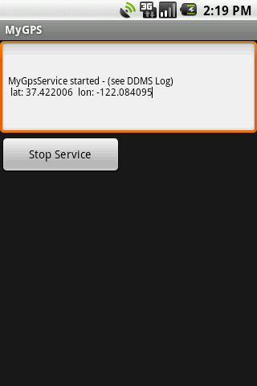
Example 5 – Obtain Location from GPS
<?xml version="1.0" encoding="utf-8"?>
<LinearLayout
android:id="@+id/widget32"
android:layout_width="fill_parent"
android:layout_height="fill_parent"
android:orientation="vertical"
xmlns:android="http://schemas.android.com/apk/res/android”>
<EditText
android:id="@+id/txtMsg"
android:layout_width="fill_parent"
android:layout_height="120px"
android:textSize="12sp”>
</EditText>
<Button
android:id="@+id/btnStopService"
android:layout_width="151px"
android:layout_height="wrap_content"
android:text="Stop Service”>
</Button>
</LinearLayout>

Slide 10
Example 5 – Obtain Location from GPS: Manifest

