Slide 1
messaging

Slide 2
Overview
SMS sends short text messages between mobile phones.
Supports sending both text messages and data messages
MMS (multimedia messaging service) messages have allowed users to send and receive messages that include multimedia attachments such as photos, videos, and audio.
Using the SMSManager, you can replace the native SMS application to send text messages, react to incoming texts, or use SMS as a data transport layer.
Use the SEND and SEND_TO actions in Intents to send both SMS and MMS messages using a messaging application installed on the device.

Slide 3
Sending SMS/MMS thru Native App (1)
Use Intent with Intent.ACTION_SENDTO action:
Specify a target number using sms: schema notation as the Intent data.
Include the message you want to send within the Intent payload using an sms_body extra.
Intent smsIntent = new Intent(Intent.ACTION_SENDTO, Uri.parse("sms:55512345"));
smsIntent.putExtra("sms_body", "Press send to send me");
startActivity(smsIntent);

Slide 4
Sending SMS/MMS thru Native App (2)
Intent i = new
Intent(android.content.Intent.ACTION_VIEW);
i.putExtra(“address”, “5556; 5558; 5560”);
i.putExtra(“sms_body”, “Hello my friends!”);
i.setType(“vnd.android-dir/mms-sms”);
startActivity(i);

Slide 5
Sending SMS/MMS thru Native App (3)
You can also attach files (effectively creating an MMS message) to your messages
Add an Intent.EXTRA_STREAM with the URI of the resource to attach.
Set the Intent type to the mime-type of the attached resource.
Use ACTION_SEND and include the target phone number as an address extra
// Get the URI of a piece of media to attach.
Uri attached_Uri = Uri.parse("content://media/external/images/media/1");
// Create a new MMS intent
Intent mmsIntent = new Intent(Intent.ACTION_SEND, attached_Uri);
mmsIntent.putExtra("sms_body", "Please see the attached image");
mmsIntent.putExtra("address", "07912355432");
mmsIntent.putExtra(Intent.EXTRA_STREAM, attached_Uri);
mmsIntent.setType("image/png");
startActivity(mmsIntent);

Slide 6
Sending SMS Manually
SMS messaging in Android is handled by the SmsManager.
SmsManager smsManager = SmsManager.getDefault();
Specify the SEND_SMS uses-permission.
<uses-permission android:name="android.permission.SEND_SMS"/>
Use sendTextMessage from the SMS Manager, passing in the address (phone number) of your recipient and the text message you want to send,
String sendTo = "5551234";
String myMessage = "Android supports programmatic SMS messaging!";
smsManager.sendTextMessage(sendTo, null, myMessage, null, null);

Slide 7
Tracking and Confirming SMS Delivery
The final two parameters in sendTextMessage let you specify Intents to track the transmission and delivery.
Implement and register corresponding Broadcast Receivers that listen for the actions you specify when creating the Pending Intents you pass in sendTextMessage.
Intent parameter, sentIntent, is fired when the message either is successfully sent or fails to send.
Activity.RESULT_OK
SmsManager.RESULT_ERROR_GENERIC_FAILURE
SmsManager.RESULT_ERROR_RADIO_OFF
SmsManager.RESULT_ERROR_NULL_PDU
The second Intent parameter, deliveryIntent, is fired only after the destination recipient receives your SMS message.

Slide 8
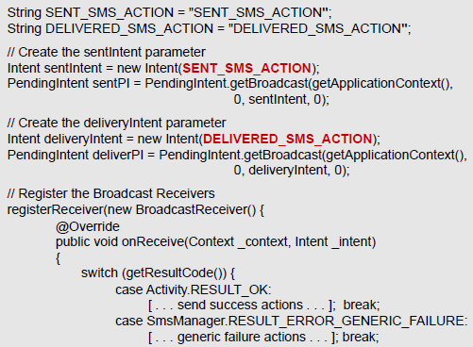
SMS delivery monitoring pattern

Slide 9
SMS delivery monitoring pattern

Slide 10
Handling Incoming SMS Messages
• With received SMS, new broadcast Intent is fired with the “android.provider.Telephony.SMS_RECEIVED“ action.
• Specify the RECEIVE_SMS manifest permission.
<uses-permission android:name="android.permission.RECEIVE_SMS"/>
Use the pdu extras key to extract an array of SMS PDUs each of which represents an SMS message
Call SmsMessage.createFromPdu to convert each PDU byte array into an SMS Message object
Bundle bundle = intent.getExtras();
if (bundle != null) {
Object[] pdus = (Object[]) bundle.get("pdus");
SmsMessage[] messages = new SmsMessage[pdus.length];
for (int i = 0; i < pdus.length; i++)
messages[i] = SmsMessage.createFromPdu((byte[]) pdus[i]);
}

Slide 11
Example of Incoming SMS Messages
Register the Broadcast Receiver using an Intent Filter that listens for the android.provider.Telephony.SMS_RECEIVED action String.
Broadcast Receiver implementation whose onReceive handler checks incoming SMS texts that start with the string @echo, and then sends the same text back to the number that sent it.

Slide 12
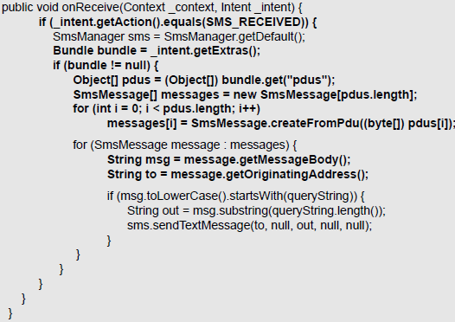
Example of Incoming SMS Messages

Slide 13
EMail
private void sendEmail(String[] emailAddresses, String[] carbonCopies,
String subject, String message)
{
Intent emailIntent = new Intent(Intent.ACTION_SEND);
emailIntent.setData(Uri.parse(“mailto:”));
String[] to = emailAddresses;
String[] cc = carbonCopies;
emailIntent.putExtra(Intent.EXTRA_EMAIL, to);
emailIntent.putExtra(Intent.EXTRA_CC, cc);
emailIntent.putExtra(Intent.EXTRA_SUBJECT, subject);
emailIntent.putExtra(Intent.EXTRA_TEXT, message);
emailIntent.setType(“message/rfc822”);
startActivity(Intent.createChooser(emailIntent, “Email”));
}

